Slide 1

Wireless Networking
Ambuj Varshney
Assistant Professor, National University of Singapore
Wireless, Embedded Intelligence, Sensing, and Emerging Technologies Group
ambujv@nus.edu.sg

Slide 2
Administration and Course Logistics

Slide 3
Course Project
Project: Apply a number of different concepts and design a working system
Neighbour discovery
Proximity detection
Interfacing sensors
Opportunistic networking
Deadline: 21st April 2023/ With penalty (10%) 28th April 2023
Should be done in a group. Need to submit only one report per group.
Notes:
++ We may all have heard of the term Internet of Things. So how are these wireless embedded systems related to the Internet of Things: Today, IoT includes a broad class of devices, including powerful platforms such as smartphones. However, it also includes more resource-constrained devices and what we call Wireless Embedded Systems, and in fact, I consider it to be one of the essential parts of the IoT ecosystem.
++ These are platforms equipped with a radio transceiver, sensor, microcontroller, and some form of energy storage. These platforms also often form a network, and sensor network as it is called has been an active area of research for the past two decades.
++ The research community has also developed wireless embedded platforms which we may know about, and these include: CMUCAM, which is an image sensor platform developed at Carnegie Mellon University, or Permamote is long life sensor platform from the lab I am associated with at UC Berkeley or Lorea which is a long-range backscatter platform that I had developed as part of my doctoral dissertation at Uppsala University. All of these are an example of Wireless Embedded Systems.

Slide 4
Examination
Two hours long, Paper-Pen (Hard Copy)
Drafted: 5 questions, 40 marks overall
Open book examination
Lecture notes, slides, any printed non electronic material is allowed
Approved calculators are allowed
No Laptop/Tablet ☹ (not in my hand)
How do examination questions look like? Please attend tutorial next week
Notes:
++ We may all have heard of the term Internet of Things. So how are these wireless embedded systems related to the Internet of Things: Today, IoT includes a broad class of devices, including powerful platforms such as smartphones. However, it also includes more resource-constrained devices and what we call Wireless Embedded Systems, and in fact, I consider it to be one of the essential parts of the IoT ecosystem.
++ These are platforms equipped with a radio transceiver, sensor, microcontroller, and some form of energy storage. These platforms also often form a network, and sensor network as it is called has been an active area of research for the past two decades.
++ The research community has also developed wireless embedded platforms which we may know about, and these include: CMUCAM, which is an image sensor platform developed at Carnegie Mellon University, or Permamote is long life sensor platform from the lab I am associated with at UC Berkeley or Lorea which is a long-range backscatter platform that I had developed as part of my doctoral dissertation at Uppsala University. All of these are an example of Wireless Embedded Systems.

Slide 5
Tutorials
No tutorial on Thursday (NUS well being day)
Optional session next week also
Practice examination questions; Clarifying doubts about anything that you may have learnt during the course
Attend next week for solutions to examination questions
Notes:
++ We may all have heard of the term Internet of Things. So how are these wireless embedded systems related to the Internet of Things: Today, IoT includes a broad class of devices, including powerful platforms such as smartphones. However, it also includes more resource-constrained devices and what we call Wireless Embedded Systems, and in fact, I consider it to be one of the essential parts of the IoT ecosystem.
++ These are platforms equipped with a radio transceiver, sensor, microcontroller, and some form of energy storage. These platforms also often form a network, and sensor network as it is called has been an active area of research for the past two decades.
++ The research community has also developed wireless embedded platforms which we may know about, and these include: CMUCAM, which is an image sensor platform developed at Carnegie Mellon University, or Permamote is long life sensor platform from the lab I am associated with at UC Berkeley or Lorea which is a long-range backscatter platform that I had developed as part of my doctoral dissertation at Uppsala University. All of these are an example of Wireless Embedded Systems.

Slide 6
Review of Last Lecture

Slide 7
Learning Objective for Today’s Lecture
Review: last few lecture’s topics
ZigBee
WiFi
Recall: WiFi Mac
WiFi History
Cellular basics

Slide 8
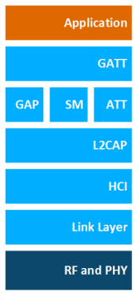
BLE Layers
GAP
Host – Configuration and Server
GAP – Generic Access Profile
Configure advertising
GATT – Generic Attribute profile
Configure connections
HCI - Host Controller Interface
Controller - Communication
Link Layer – send packets
RF and PHY – send bits
Host
Controller

Slide 9
Two different communication modes in BLE
Advertising
Discovery
Advertisements – broadcast messages indicating device details
Ephemeral, uni-directional communication from Advertiser to Scanner(s)
ALOHA access control
Connections
Interaction
Bi-directional communication between Peripheral and Central
Maintained for some duration
TDMA access control

Slide 10
BLE network topology
Peripheral
Connection
Central & Scanner
Scanner
Connection
Peripheral
Advertisement
Advertisement
Advertisement
Advertisement
Advertiser
Advertiser
Advertiser

Slide 11
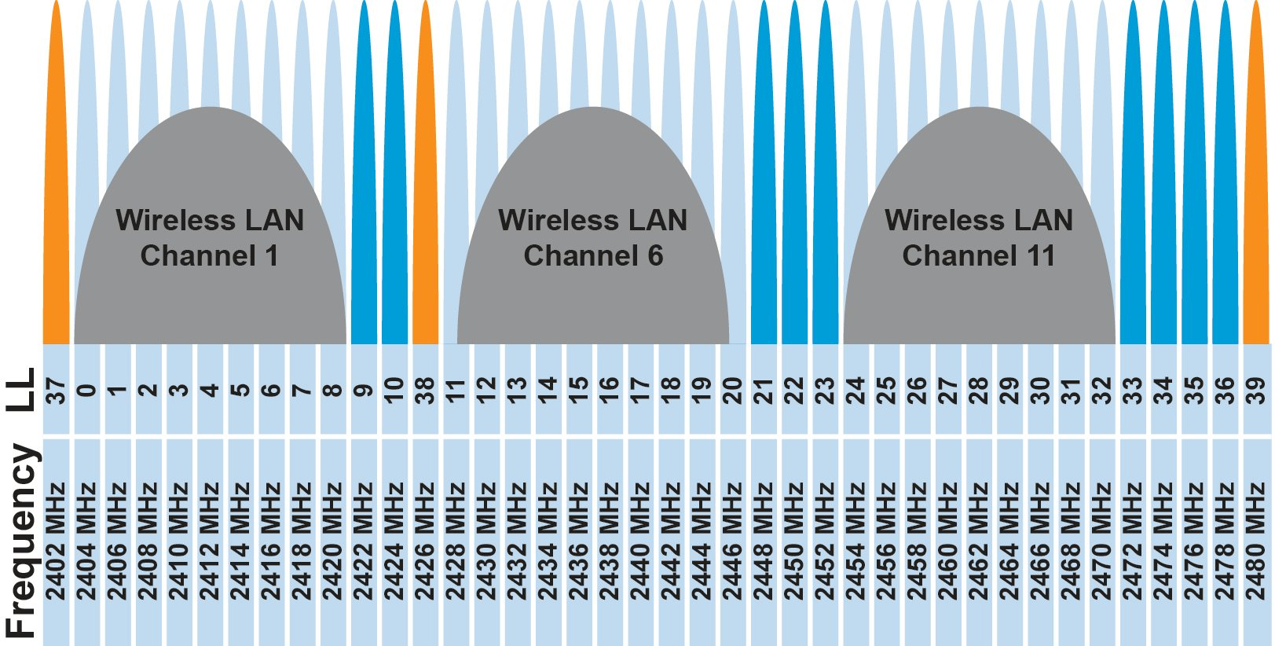
BLE frequency
2.4 GHz carrier, Forty 2-MHz channels, 1 Mbps data rate
37, 38, 39 for advertising
0-36 for connection (FHSS)

Slide 12
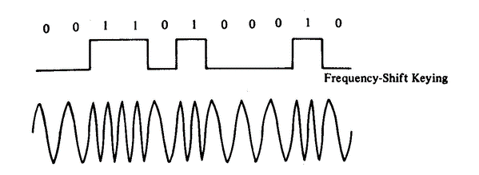
BLE modulation
Gaussian Frequency-Shift Keying (GFSK)
Improvement on base Frequency-shift Keying
Smoother transitions between bits -> reduces nearby interference

Slide 13
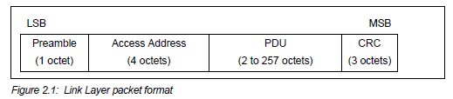
Packet structure
Same packet structure for both advertisements and connections
Fields are filled in little endian (the opposite of network byte order )
Access address unique for each connection (randomly chosen)
In Advertising always set to 0x8E89BED6

Slide 14
Advertising
BLE discovery mechanism
Make nearby devices aware of advertiser’s existence
Communicate some information from or about advertiser
Traditional purpose is to enable connections, but this is also useful for general communication
Advertisements
Periodic broadcast messages with data
Scan Requests/Responses
Scanner sends responses after getting a request
Only occurs when scanner is listening

Slide 15
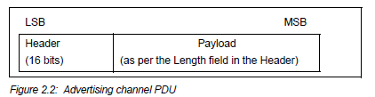
Advertising packet layering

Slide 16
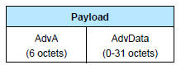
Advertisement payloads
AdvA – address of the advertiser
TxAdd bit from header specifies if this is a “public” or “random” address
Remaining up to 31 bytes are available for use
Putting it all together, up to 47 bytes total:
BLE Packet
Advertising PDU
Preamble 1 Byte | Access Address 4 Bytes | Header 2 Bytes | Advertiser Address 6 Bytes | Advertiser Data (Payload) 0-31 Bytes | CRC 3 Bytes

Slide 17
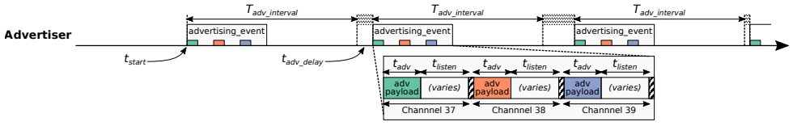
Advertising event
Three transmissions, one on each advertising channel
Always in the same order
Transmission, followed by listening window on that same channel
Requests will be sent >=150 us (Inter-Frame Spacing, IFS) after Tx
Followed by a retune to the next channel frequency
Short listen window to enable low-power operations

Slide 18
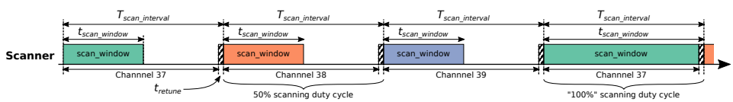
Scanning Pattern
Iterate through channels, listening for advertisements
T_{scan_interval} controls rate at which channels are changes
T_{scan_window} controls duty cycle of listening
Why listen at a low duty cycle? Save energy

Slide 19
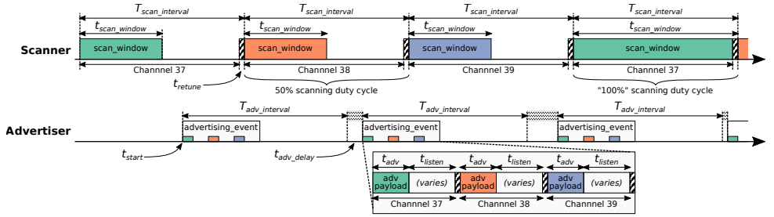
Putting it all together
Advertisements are received when the channel of the scan window and the channel of the advertisement overlap in time (and space)

Slide 20
Overview of connections
Connections are for bi-directional communication with higher throughput than advertisements
Simple view
A peripheral is either advertising or in a connection
A central is scanning and in one or more connections
(Remember: devices can have many roles simultaneously)
While in a connection both devices act like servers
Either device can read/write fields available on the other device

Slide 21
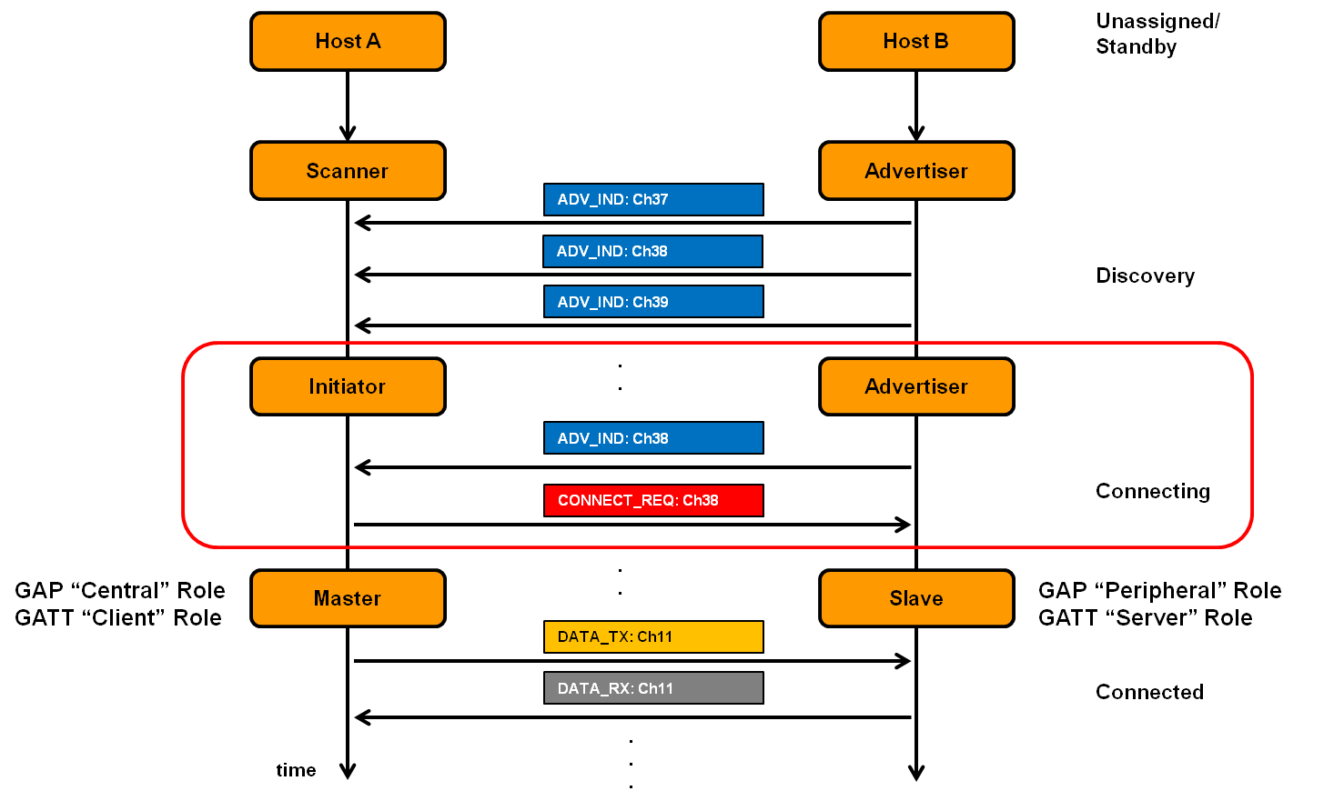
Connection timeline (in picture form)
Central
Peripheral

Slide 22
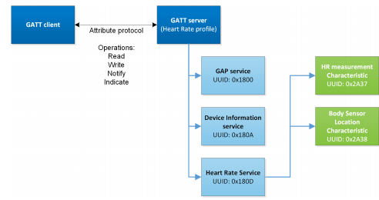
Overview of Generic Attribute Profile (GATT)

Slide 23
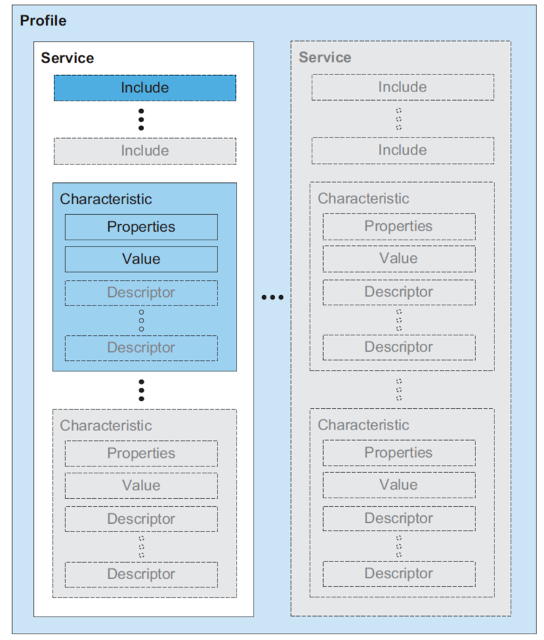
Attribute server keywords
Characteristic
A field with properties and a value
Descriptor: metadata about the characteristic
Service
Collection of characteristics
Profile
Collection of services

Slide 24
UUIDs and handles
Universally Unique Identifiers
128-bit, mostly random with a few bits for versioning
Example: 00000000-0000-1000-8000-00805F9B34FB
This is the default BLE UUID for known services
You can generate your own UUID for custom services
Handles
Too long to pass around all the time, so pick 16 bits that mean that UUID
Must be unique among services/characteristics on that device
Taken from UUID: 0000xxxx-0000-1000-8000-00805F9B34FB
Handle often sequentially incremented for each new characteristic within a service

Slide 25
Discovery
When a connection first occurs, each device can query the other for a list of services
And can further query for a list of characteristics in that service
Gets a list of handles/UUIDs
Standardized UUIDs can be interpreted immediately
Custom services/characteristics need documentation from the manufacturer

Slide 26
Revised physical layers
2 Mbps PHY
Transmit data faster
Transmit more data in the same time
Coded PHY
Forward Error Correction in the data stream
1 bit -> 2 symbols or 8 symbols
Makes bits more reliable -> longer distance
500 kbps and 125 kbps modes
Connections can switch to these PHYs after creation
Advertisements can use these with extensions only

Slide 27
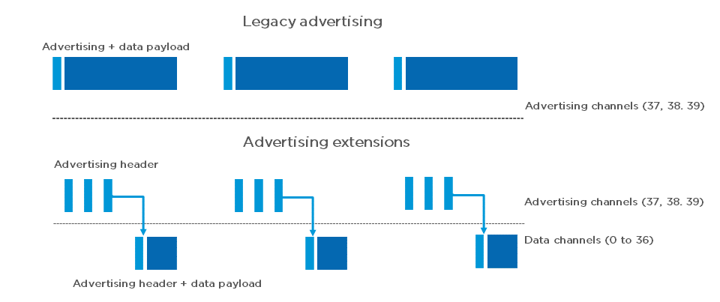
Extended advertising
Allow bigger payloads and/or different PHYs
Uses Data Channels to do so. Why?
Regular advertisements point to extended advertisements

Slide 28
Extended advertising
Allow bigger payloads and/or different PHYs
Uses Data Channels to do so. Why? Packet collisions!
Regular advertisements point to extended advertisements

Slide 29
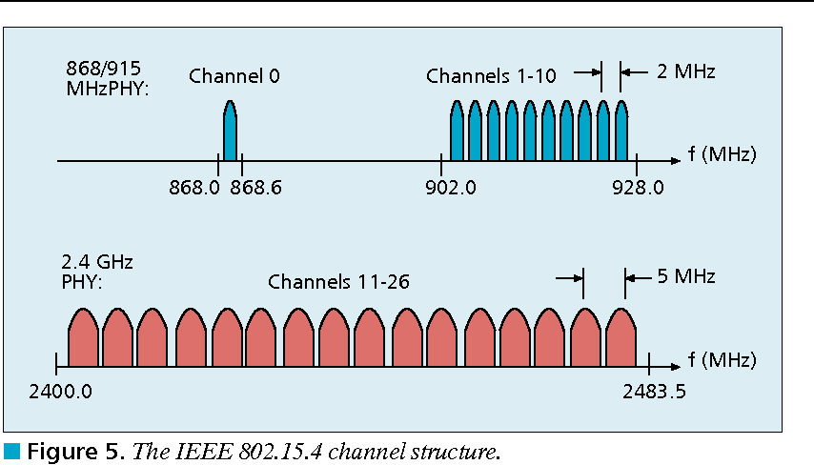
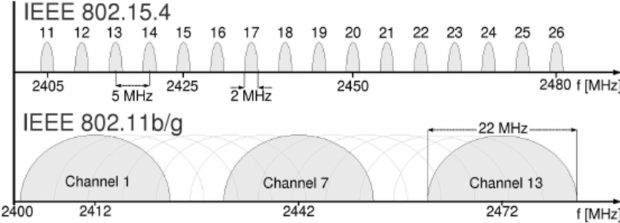
802.15.4 RF channels
27 channels across three bands
5 MHz channel separation at 2.4 GHz
Compare to 2 MHz for BLE

Slide 30
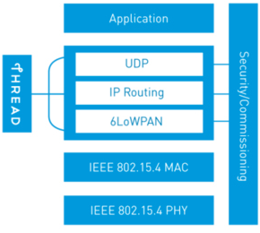
Thread overview
Build a networking layer on top of 15.4
Reuses most of PHY and MAC
Adds IP communication
Handles addressing and mesh maintenance
Goals
Simplicity – easy to install and operate
Efficiency – years of operation on batteries
Scalability – hundreds of devices in a network
Security – authenticated and encrypted communication
Reliability – mesh networking without single point of failure
Industry-focused, but based in academic research

Slide 31
Changes to Physical Layer
Remove all non-2.4 GHz PHY options
Otherwise the same
OQPSK
16 channels, 5 MHz spacing
Typical TX power 0 dBm
Typical RX sensitivity -100 dBm

Slide 32


Changes to Link Layer and MAC
Non-beacon-enabled PAN only
No superframe structure
No periodic beacons
No Guaranteed Time Slots
Throw out most existing MAC Commands
Remove network joining/leaving
Remove changing coordinators
Remove Guaranteed Time Slot request
Network joining will be handled at a higher layer

Slide 33
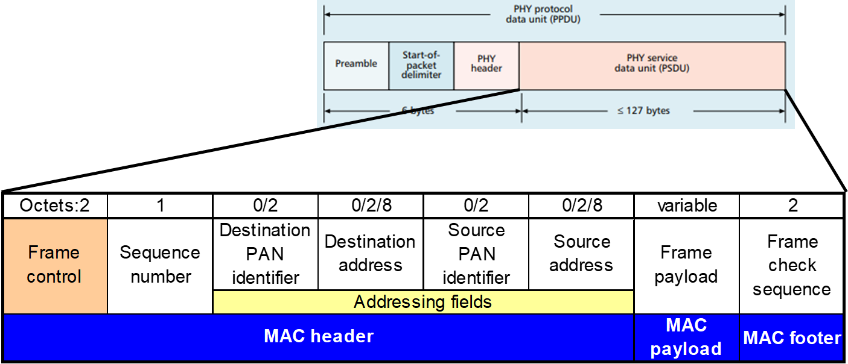
Changes to Link Layer and MAC
Keep unslotted CSMA/CA algorithm
Keep packet structure
Keep Frame Types
Beacon
MAC Command
Beacon Request
Data Request
Data
Acknowledgement

Slide 34
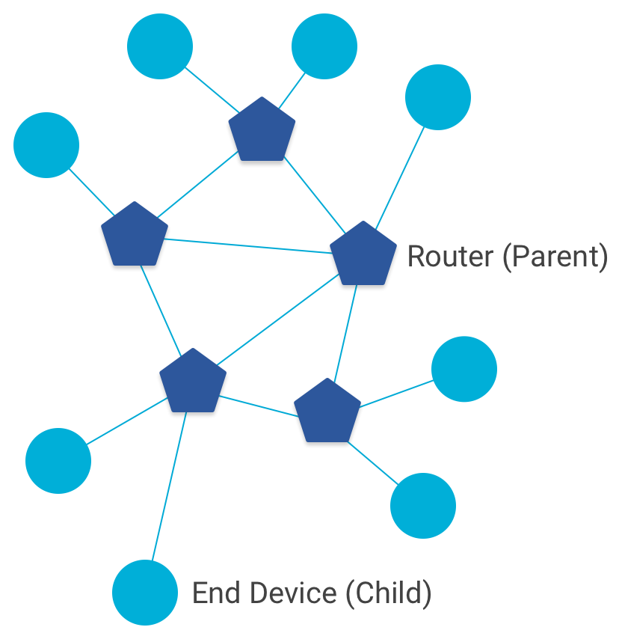
Combination of star and mesh topology
Routers (parent)
Mesh communication with other routers
Radio always on
Forwards packets for network devices
Enables other devices to join network
32 routers per network
End devices (child)
Communicates with one parent (router)
Does not forward packets
Can disable transceiver to save power
Send packets periodically to avoid timeout
511 end devices per router

Slide 35
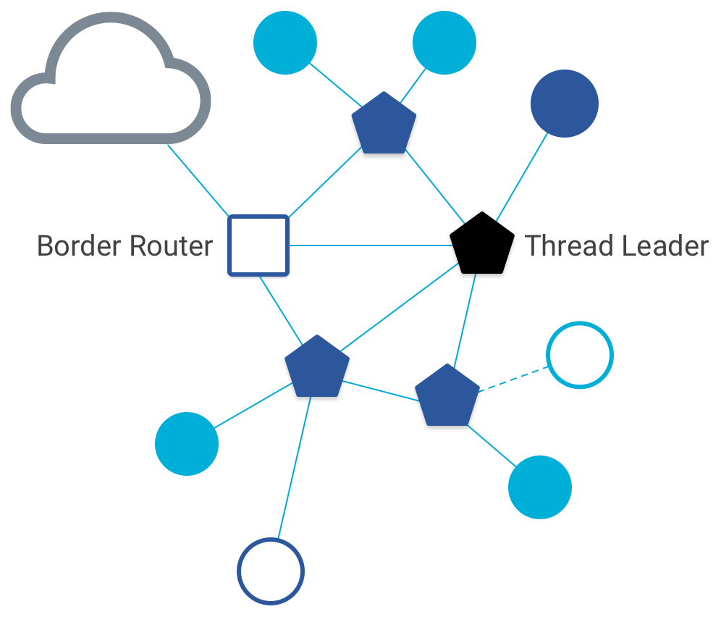
Other special roles
Thread leader
Device in charge of making decisions
Addresses, Joining details
Automatically selected from routers
One leader at any given time
Additional leader is selected if the network partitions
Border router
Router that also has connectivity to another network
Commonly WiFi or Ethernet
Provides external connectivity
Multiple border routers may exist at once

Slide 36
Thread uses IPv6 for communication
Why IP?
If Wireless Sensor Networks represent a future of billions of connected devices distributed throughout the physical world
Why shouldn’t they run standard protocols wherever possible?
Why IPv6?
Generalized, Flexible, Capable
Benefits
Interoperability with normal computers and networks
Reuse state of the art developed standards instead of remaking them
Security, Naming, Discovery, Services
Costs
Packet overhead can be high (will fix)
Complexity for supporting protocols
Hui and Culler, “IP is Dead, Long Live IP for Wireless Sensor Networks”. 2008

Slide 37
Background: IPv6
Replacement to Internet Protocol v4
Extended addressing for devices
32-bits for IPv4 addresses -> 128-bits for IPv6 addresses
Example: a39b:239e:ffff:29a2:0021:20f1:aaa2:2112
Supports multiple transmit models
Broadcast: one-to-all
Multicast: one-to-many
Unicast: one-to-one
Various other improvements

Slide 38
Background: IPv6 address notation rules
Groups of zeros can be replaced with “::”
Can only use “::” in one place in the address
Leading zeros in a 16-bit group can be omitted
0000:0000:0000:0000:0000:0000:0000:0001 → ::1
2345:1001:0023:1003:0000:0000:0000:0000 → 2345:1001:23:1003::
aecb:0222:0000:0000:0000:0000:0000:0010 → aecb:222::10
Special addresses
Localhost - ::1 (IPv4 version is 127.0.0.1)
Link-Local Network - fe80:: (bottom 64-bits are ~device MAC address)
Local Network – fc00:: and fd00::
Global Addresses – 2000:: (various methods for allocating bottom bits)

Slide 39
Background: IPv6 datagram format
Priority: like “type of service” in IPv4.
Flow label: ambiguous
Next header: TCP, UDP
Hop limit = TTL
version
priority
flow label
payload length
next header
hop limit
source address
(128 bits)
destination address
(128 bits)
data
(variable length, typically a TCP or UDP segment)
how much overhead?
40 bytes of IPv6
20 more than IPv4
32 bits

Slide 40
6LoWPAN header compression
40 bytes of IPv6 header are a lot for a 127-byte payload
Most important goals
Communication with devices in the 15.4 network should be low-overhead
Communication outside of the 15.4 network should still minimize overhead where possible
Assume a bunch of common parameters to save space
A bunch of options are set to default values
Payload length can be re-determined from packet length
Source/Destination addresses can often be reassembled from link layer data
Plus information about network address assignment known by routers
Border router “inflates” the packet before sending externally

Slide 41
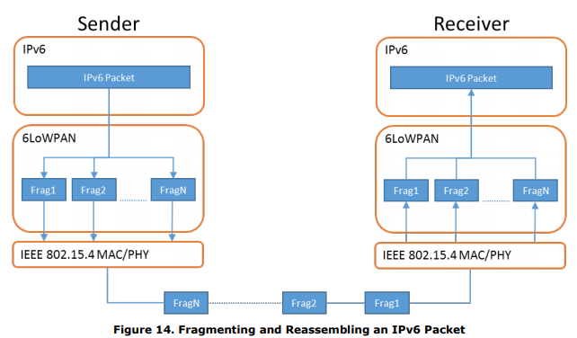
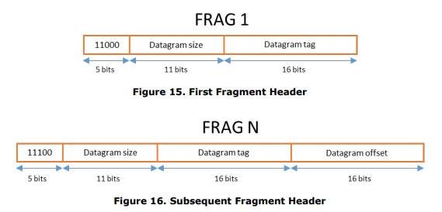
6LoWPAN fragmentation
Only the first packet of the fragments will hold the IPv6 header
Tag, offset, and size are used to reconstruct

Slide 42
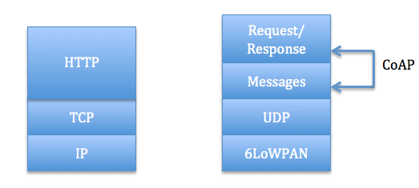
Constrained Application Protocol - CoAP
HTTP, but over UDP targeting less-capable devices
Same REST architecture
Adds capability for automatic retransmissions
CoAP Requests
Have a type: GET, POST, PUT, DELETE
Have a URL: /file/etc
Have data up to 65 KB

Slide 43
Learning Objective for Today’s Lecture
Review: last few lecture’s topics
ZigBee
WiFi
Recall: WiFi Mac
WiFi History
Cellular basics

Slide 44
ZigBee goals
Enable automatic communication between devices
Low complexity
Low power
Focus on home automation and industrial control/monitoring
From our perspective
802.15.4 PHY and MAC
Designed for higher-power devices than Thread or BLE
Although still relatively low power

Slide 45
ZigBee history
Intertwined with the creation of 802.15.4
Both are founded around the same time
ZigBee Alliance involved in the original 802.15.4 specification
Recently renamed: Connectivity Standards Alliance (CSA)
Original plan: 802.11/WiFi <-> 802.15.4/ZigBee

Slide 46
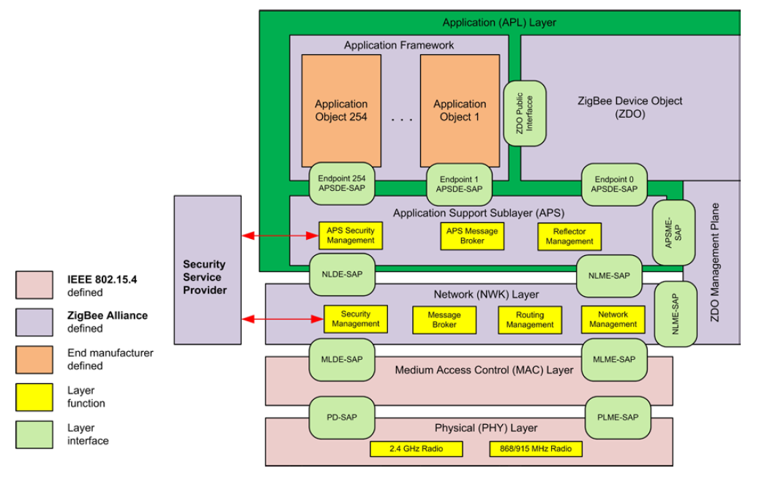
ZigBee stack

Slide 47
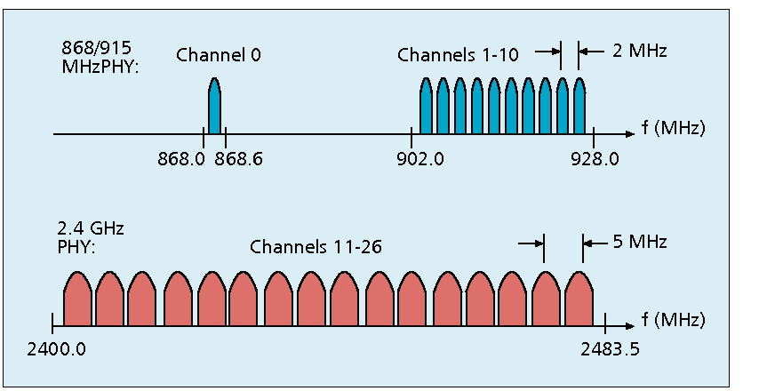
Use of 802.15.4
Basic answer: everything
Reuse all of PHY (including non-2.4 GHz channels)
Reuse all of MAC (including beacon-enabled network and GTS)
Same CSMA/CA mechanism

Slide 48
ZigBee devices (same roles as 802.15.4 defines)
ZigBee Coordinator (ZC)
Starts the network and decides on key parameters
Is also a Router
ZigBee Router (ZR)
Higher-power, more-capable devices
Radios always on (except during inactive superframe)
Connect to one or more children
Connect to one or more routers
ZigBee End Device (ZED)
Lower-power, less-capable devices
Always a child of one router

Slide 49
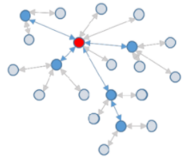
Older ZigBee - tree networks
Original preferred topology
Uses beacon-enabled network
Synchronization via beacon superframes
Can reduce power requirements for routers
Some things get simpler
Address assignment is simple
If you restrict network size
Routing is straightforward
But likely more hops for router-to-router communication

Slide 50
ZigBee tree network complications
Distributed routing scheme limits topologies
There is a limit on number of routers
Each router has a maximum number of children
There is a maximum limit for router depth
Needs a beacon scheduling mechanism
Each parent must both participate in a superframe
And also send their own superframe beacons
Need to keep inactive period large if there is significant router depth
Each beacon includes a TX offset field specifying parent beacon time
Helps prevent hidden terminal problem

Slide 51
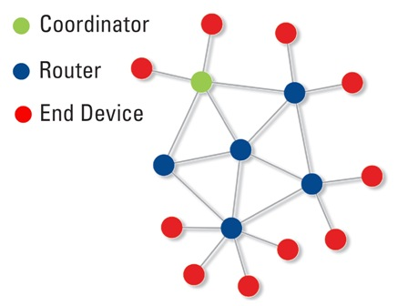
Modern ZigBee – mesh networks
Presently preferred topology
Uses non-beacon-enabled network
All routers are always-on devices
Allows arbitrary communication between routers
Some tradeoffs
Higher power routers
Routing more complicated (potentially better algorithms though)
Addressing more complicated
Assign random addresses to each node
Include a method for address conflict resolution

Slide 52
ZigBee End Device polling
Packets are held in ZigBee Routers for up to 7.68 seconds
Compare to undefined duration for Thread (at least minutes)
Reduction in “low energy” capability for end devices
Limiting timeouts makes Router design simpler
ZigBee codifies polling behavior for End Devices
Long Polling - steady state polling period, example: 7.5 seconds
Short Polling – polling period while waiting on data, example: 1 second

Slide 53
ZigBee application-layer terms
Devices act as servers and clients
Profiles – details application-level features
Includes network configurations
For example: security or reliability
Includes definitions of various Device Types
Specify a collection mandatory and optional Clusters
Clusters – collection of Attributes and Commands
Attributes – information, readable and/or writable
Commands – control, writable, may elicit a response

Slide 54
Analogies between BLE and ZigBee
BLE Profile
BLE Service
BLE Characteristic
ZigBee Profile + Device Type
ZigBee Cluster
ZigBee Attribute
Also ~ZigBee Commands

Slide 55
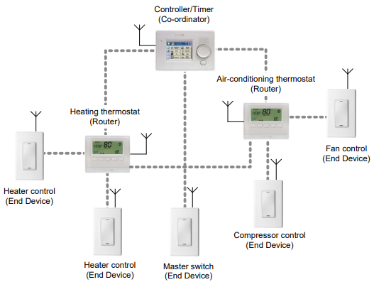
Example ZigBee network

Slide 56
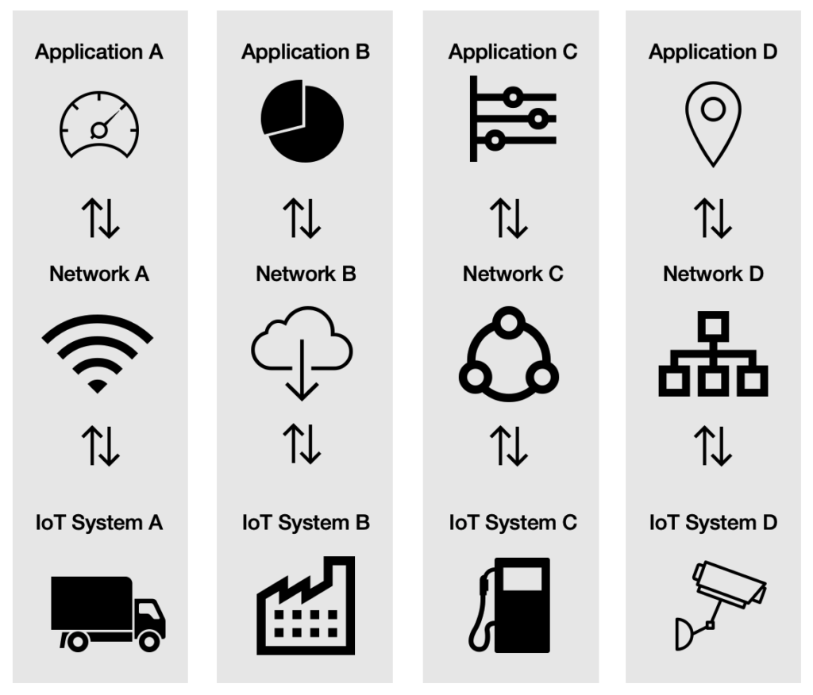
A problem: the siloed internet of things
Problem: companies are more interested in selling you the whole stack
Which then makes it harder for devices to be interoperable
This is not Thread or IP-specific, but a problem all IoT devices are facing

Slide 57
Learning Objective for Today’s Lecture
Review: last few lecture’s topics
ZigBee
WiFi
Recall: WiFi Mac
WiFi History
Cellular basics

Slide 58
Basic facts about WiFi
Most of us know about WiFi! Laptops, mobile phones, other devices?
Covers small area (approx. 10 to 30 meters), Very high speed
The WiFi standard is almost 30 years old!
Notes:
++ While we are deploying an enormously large number of IoT devices, I claim that very little attention is being paid to their energy challenge.
++ Today, most IoT devices are very energy expensive, and consequently, they rely on bulky batteries such as AA/AAA sized batteries for their operation. Even when operating on these batteries, they require frequent replacement of the exhausted batteries. This can be challenging when performed at a massive scale, especially considering that we may have a trillion embedded device deployed in the world.
++ Further, it can also harm the environment. These batteries use toxic chemicals, which means now we can have billions of toxic chemicals laden batteries that would be disposed of in landfills. This is especially important as sustainability has become an essential aspect across the world; in fact, imperial college was celebrating sustainability week.

Slide 59
Basic facts about WiFi
Most of us know about WiFi! Laptops, mobile phones, other devices?
Covers small area (approx. 10 to 30 meters), Very high speed
The WiFi standard is almost 30 years old!
Notes:
++ While we are deploying an enormously large number of IoT devices, I claim that very little attention is being paid to their energy challenge.
++ Today, most IoT devices are very energy expensive, and consequently, they rely on bulky batteries such as AA/AAA sized batteries for their operation. Even when operating on these batteries, they require frequent replacement of the exhausted batteries. This can be challenging when performed at a massive scale, especially considering that we may have a trillion embedded device deployed in the world.
++ Further, it can also harm the environment. These batteries use toxic chemicals, which means now we can have billions of toxic chemicals laden batteries that would be disposed of in landfills. This is especially important as sustainability has become an essential aspect across the world; in fact, imperial college was celebrating sustainability week.

Slide 60
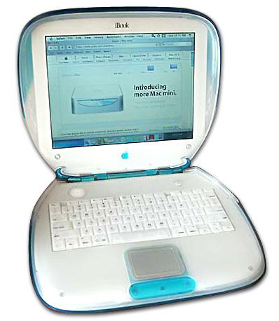
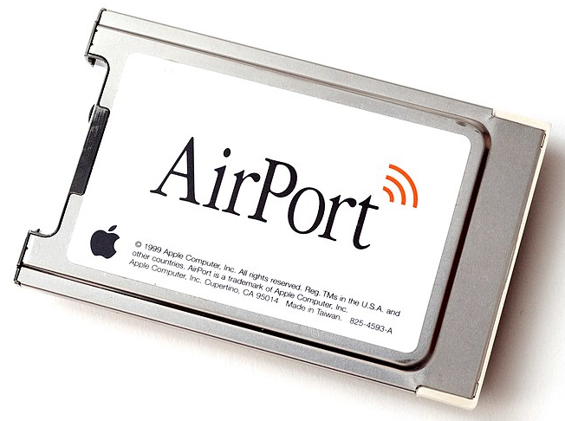
WiFi standard timeline
1985 – US FCC rules ISM band for unlicensed use
1990s – WaveLAN (NCR Corporation, Netherlands)
Wireless ethernet for cashier systems
1997 – 802.11 specification
1999 – 802.11b and 802.11a amendments
1999 – WiFi Alliance formed for certification of devices
1999 – Apple iBook is the first consumer WiFi product
Notes:
++ While we are deploying an enormously large number of IoT devices, I claim that very little attention is being paid to their energy challenge.
++ Today, most IoT devices are very energy expensive, and consequently, they rely on bulky batteries such as AA/AAA sized batteries for their operation. Even when operating on these batteries, they require frequent replacement of the exhausted batteries. This can be challenging when performed at a massive scale, especially considering that we may have a trillion embedded device deployed in the world.
++ Further, it can also harm the environment. These batteries use toxic chemicals, which means now we can have billions of toxic chemicals laden batteries that would be disposed of in landfills. This is especially important as sustainability has become an essential aspect across the world; in fact, imperial college was celebrating sustainability week.

Slide 61
Timeline of development of WiFi standard
 | Protocol | Year | Frequency | PHY | Max Rate | Range
- | 802.11 | 1997 | 2.4 GHz | DSSS/FHSS | 2 Mbps | 20 m
1 | 802.11b | 1999 | 2.4 GHz | DSSS | 11 Mbps | 35 m
2 | 802.11a | 1999 | 5 GHz | OFDM | 54 Mbps | 35 m
3 | 802.11g | 2003 | 2.4 GHz | OFDM | 54 Mbps | 38 m
4 | 802.11n | 2009 | 2.4/5 GHz | OFDM + MIMO | 600 Mbps | 70 m
5 | 802.11ac | 2013 | 5 GHz | OFDM + MU-MIMO [downlink only] | 3.4 Gbps | 35 m
6 | 802.11.ax | 2021 | 2.5/5 [/6] GHz | OFDMA + MU-MIMO | 9.6 Gbps | 35 m
Notes:
++ While we are deploying an enormously large number of IoT devices, I claim that very little attention is being paid to their energy challenge.
++ Today, most IoT devices are very energy expensive, and consequently, they rely on bulky batteries such as AA/AAA sized batteries for their operation. Even when operating on these batteries, they require frequent replacement of the exhausted batteries. This can be challenging when performed at a massive scale, especially considering that we may have a trillion embedded device deployed in the world.
++ Further, it can also harm the environment. These batteries use toxic chemicals, which means now we can have billions of toxic chemicals laden batteries that would be disposed of in landfills. This is especially important as sustainability has become an essential aspect across the world; in fact, imperial college was celebrating sustainability week.

Slide 62

iBook (1999)
Notes:
++ While we are deploying an enormously large number of IoT devices, I claim that very little attention is being paid to their energy challenge.
++ Today, most IoT devices are very energy expensive, and consequently, they rely on bulky batteries such as AA/AAA sized batteries for their operation. Even when operating on these batteries, they require frequent replacement of the exhausted batteries. This can be challenging when performed at a massive scale, especially considering that we may have a trillion embedded device deployed in the world.
++ Further, it can also harm the environment. These batteries use toxic chemicals, which means now we can have billions of toxic chemicals laden batteries that would be disposed of in landfills. This is especially important as sustainability has become an essential aspect across the world; in fact, imperial college was celebrating sustainability week.

Slide 63
Learning Objective for Today’s Lecture
Review: last few lecture’s topics
ZigBee
WiFi
Recall: WiFi Mac
WiFi History
Cellular basics

Slide 64
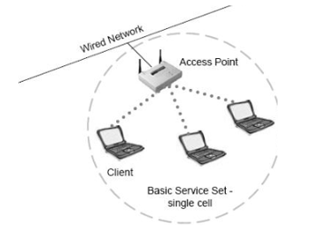
Basic WiFi network
Star topology network
Basic Service Set (BSS)
Access point(s)
Multiple connected clients
Service Set ID (SSID)
Identifies network
Broadcast by access point in beacons

Slide 65
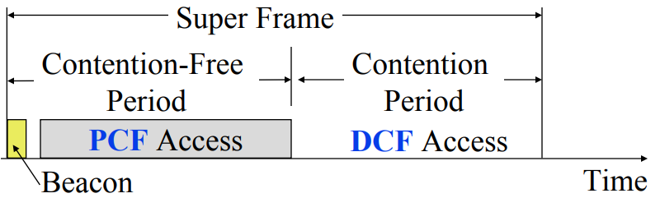
WiFi superframe structure
Beacon followed by contention-free period followed by contention
Repeats periodically (default ~100 ms)
802.15.4 adopted a similar superframe

Slide 66
WiFi superframe in practice
Continuous contention access period
Any device may send at any time
PCF is unused in practice
Periodic beacons
Which also use CSMA and therefore may be delayed
Contention
Based Access
Delayed Beacon
Beacon
Time

Slide 67
Contention-based access
Known as Distributed Coordination Function (DCF)
Base communication method for WiFi (essentially always)
All packets are immediately ACK’d by receiving device
Uses CSMA/CA to determine when it can send
With random backoff
Problem: packets can be very long (up to 20 milliseconds)
Solution: Network Allocation Vector (NAV)
Packets include a notation of their duration
Sensing the beginning of a packet allows backoff to skip the whole packet duration before continuing

Slide 68
Backoff in WiFi
Listen for activity
If free
Wait for Inter Frame Spacing (IFS)
If still free, transmit
If busy
Randomly select a number of backoff Slots
Count down slots whenever medium is not busy
If busy when backoff completes:
Increase maximum backoff Slots
Repeat
Slot time: basic time unit for protocol
Total time of: switch from Rx to Tx, plus processing time, plus propagation delay

Slide 69
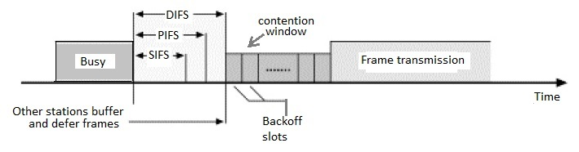
Prioritizing packets with varying IFS
Tiered Contention Multiple Access (TCMA)
Idea: assign different inter-frame spacing based on traffic class
Inherently prioritizes communication
Acknowledgements sent with Short IFS (SIFS)
Will always transmit before new data clears CSMA check
New data sent with DCF IFS (DIFS)

Slide 70
802.11 backoff example
B reaches zero backoff, finds channel empty, transmits
A pauses its backoff again for duration plus ACK
Other Traffic
ACK
C Traffic
ACK
B Traffic
SIFS
DIFS
DIFS
SIFS
DIFS
A
Arrival A
Backoff = 10
Backoff = 6
B
Arrival B
Backoff = 8
Backoff = 4
C
Arrival C

Slide 71
IEEE standard for LPWANs
n.b.
802 = “area networking”
.3 = “LANs”
.11 = “Wireless LANs”
.15 = “PANs”
802.11ah (HaLow) standard in 2016
First real hardware in 2020
Still not in real-world use yet
Focus on the indoor-to-outdoor scenario
Medium range (maximum 1 km)
915 MHz communication
NOT interoperable with other 802.11 access points and devices
Theoretically up to 356 Mbps
Practically, most devices are expected to implement 150 kbps to 8 Mbps

Slide 72
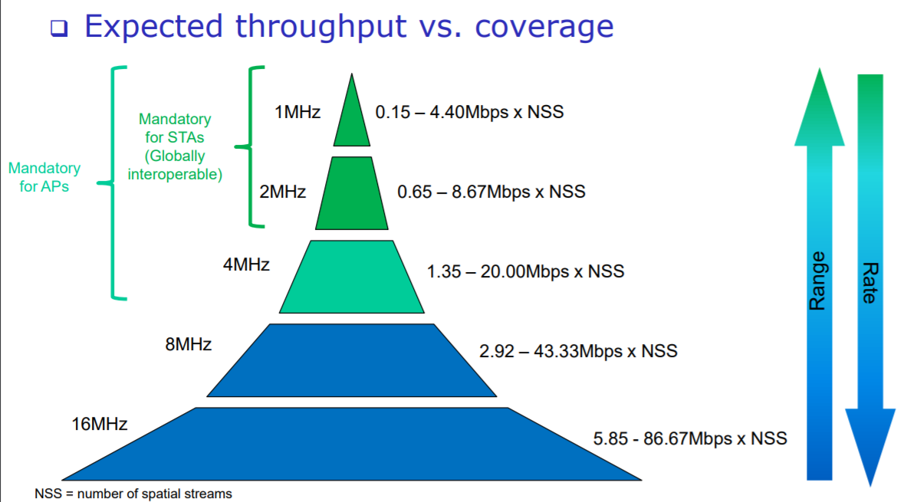
802.11ah allows multiple bandwidth allocations

Slide 73
Learning Objective for Today’s Lecture
Review: last few lecture’s topics
ZigBee
WiFi
Recall: WiFi Mac
WiFi History
Cellular basics

Slide 74
Goal: improve throughput
In twenty years, WiFi has gone from 2 Mbps to 9.6 Gbps
How does a network PHY improve its throughput?

Slide 75
Major amendments
 | Protocol | Year | Frequency | PHY | Max Rate | Range
- | 802.11 | 1997 | 2.4 GHz | DSSS/FHSS | 2 Mbps | 20 m
1 | 802.11b | 1999 | 2.4 GHz | DSSS | 11 Mbps | 35 m
2 | 802.11a | 1999 | 5 GHz | OFDM | 54 Mbps | 35 m
3 | 802.11g | 2003 | 2.4 GHz | OFDM | 54 Mbps | 38 m
4 | 802.11n | 2009 | 2.4/5 GHz | OFDM + MIMO | 600 Mbps | 70 m
5 | 802.11ac | 2013 | 5 GHz | OFDM + MU-MIMO (downlink only) | 3.4 Gbps | 35 m
6 | 802.11ax | 2021 | 2.4/5/6 GHz | OFDMA + MU-MIMO | 9.6 Gbps | 35 m
802.11b was very popular but is now usually unsupported
802.11a never saw major deployment

Slide 76
Goal: improve throughput
In twenty years, WiFi has gone from 2 Mbps to 9.6 Gbps
How does a network PHY improve its throughput?
More capable modulation and/or bit transmission
Techniques like OFDM and MIMO
More bandwidth
Increased channel with at 2.4 Ghz and bigger 5 GHz channels

Slide 77
Major amendments
 | Protocol | Year | Frequency | PHY | Max Rate | Range
- | 802.11 | 1997 | 2.4 GHz | DSSS/FHSS | 2 Mbps | 20 m
1 | 802.11b | 1999 | 2.4 GHz | DSSS | 11 Mbps | 35 m
2 | 802.11a | 1999 | 5 GHz | OFDM | 54 Mbps | 35 m
3 | 802.11g | 2003 | 2.4 GHz | OFDM | 54 Mbps | 38 m
4 | 802.11n | 2009 | 2.4/5 GHz | OFDM + MIMO | 600 Mbps | 70 m
5 | 802.11ac | 2013 | 5 GHz | OFDM + MU-MIMO (downlink only) | 3.4 Gbps | 35 m
6 | 802.11ax | 2021 | 2.4/5/6 GHz | OFDMA + MU-MIMO | 9.6 Gbps | 35 m
802.11b was very popular but is now usually unsupported
802.11a never saw major deployment

Slide 78
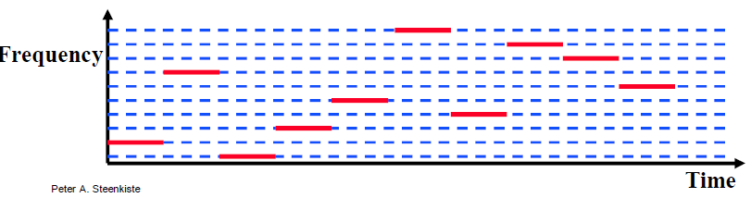
Original WiFi specification (1997)
Legacy WiFi
Frequency Hopping Spread Spectrum (FHSS)
GFSK (Gaussian Frequency-Shift Keying)
Relatively simple radio design
Frequency hopping over 80 channels (1 MHz each)

Slide 79
Major amendments
 | Protocol | Year | Frequency | PHY | Max Rate | Range
- | 802.11 | 1997 | 2.4 GHz | DSSS/FHSS | 2 Mbps | 20 m
1 | 802.11b | 1999 | 2.4 GHz | DSSS | 11 Mbps | 35 m
2 | 802.11a | 1999 | 5 GHz | OFDM | 54 Mbps | 35 m
3 | 802.11g | 2003 | 2.4 GHz | OFDM | 54 Mbps | 38 m
4 | 802.11n | 2009 | 2.4/5 GHz | OFDM + MIMO | 600 Mbps | 70 m
5 | 802.11ac | 2013 | 5 GHz | OFDM + MU-MIMO (downlink only) | 3.4 Gbps | 35 m
6 | 802.11ax | 2021 | 2.4/5/6 GHz | OFDMA + MU-MIMO | 9.6 Gbps | 35 m
802.11b was very popular but is now usually unsupported
802.11a never saw major deployment

Slide 80
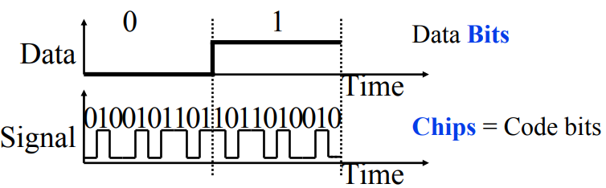
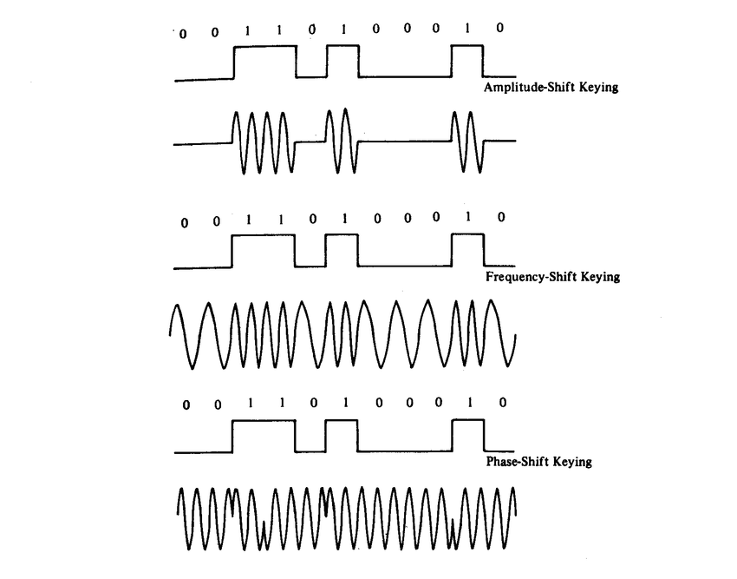
802.11b (1999)
802.11b
Direct Sequence Spread Spectrum (DSSS)
DBPSK and DQPSK (Differential Binary/Quadrature Phase-Shift Keying)
Translate data into “codes”
Each data bit corresponds to several code bits (Chips)
Chips are what is actually modulated over the air
Data can be recovered by knowing the code patterns
Modulation
Phase-shift Keying (of the Chips)

Slide 81
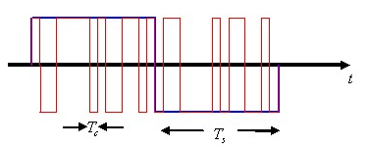
DSSS goals
DSSS increases bandwidth of a signal
Beyond what is needed for the data
Energy is smeared across the frequencies
More robust against interference
Data can be recovered from partial code
Cost: using a lot of bandwidth for only a little data

Slide 82
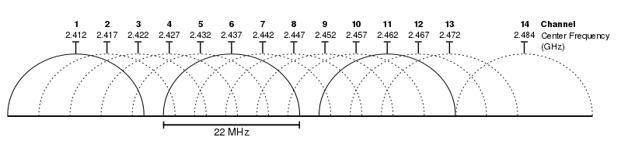
802.11b channels
14 channels total
1-11 for US
1-13 for most of the rest of the world
1-14 for Japan (but 14 only for 802.11b)
22 MHz channels
5 MHz spacing -> significant channel overlap
Channels 1, 6, and 11 can be used without overlap

Slide 83
Major amendments
 | Protocol | Year | Frequency | PHY | Max Rate | Range
- | 802.11 | 1997 | 2.4 GHz | DSSS/FHSS | 2 Mbps | 20 m
1 | 802.11b | 1999 | 2.4 GHz | DSSS | 11 Mbps | 35 m
2 | 802.11a | 1999 | 5 GHz | OFDM | 54 Mbps | 35 m
3 | 802.11g | 2003 | 2.4 GHz | OFDM | 54 Mbps | 38 m
4 | 802.11n | 2009 | 2.4/5 GHz | OFDM + MIMO | 600 Mbps | 70 m
5 | 802.11ac | 2013 | 5 GHz | OFDM + MU-MIMO (downlink only) | 3.4 Gbps | 35 m
6 | 802.11ax | 2021 | 2.4/5/6 GHz | OFDMA + MU-MIMO | 9.6 Gbps | 35 m
802.11b was very popular but is now usually unsupported
802.11a never saw major deployment

Slide 84
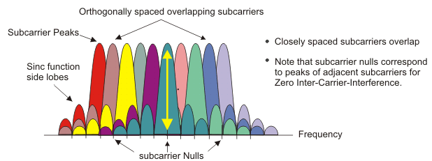
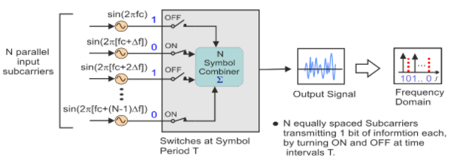
OFDM enables higher throughput
Replace DSSS with Orthogonal Frequency Division Multiplexing
OFDM idea
Split band into a number of narrow subcarriers
Subcarriers are spaced so that they don’t interfere
Transmit on multiple subcarriers at once to increase throughput
Recall DSSS

Slide 85
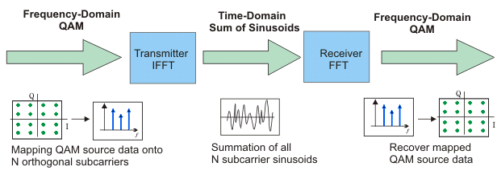
OFDM higher throughput at complexity cost
Receivers collect signal from entire channel
And then can split it apart to gain the data on each subcarrier
Tradeoffs
Benefits: more throughput, still robust against narrowband interference
Costs: more complicated and sensitive radio design

Slide 86
Major amendments
 | Protocol | Year | Frequency | PHY | Max Rate | Range
- | 802.11 | 1997 | 2.4 GHz | DSSS/FHSS | 2 Mbps | 20 m
1 | 802.11b | 1999 | 2.4 GHz | DSSS | 11 Mbps | 35 m
2 | 802.11a | 1999 | 5 GHz | OFDM | 54 Mbps | 35 m
3 | 802.11g | 2003 | 2.4 GHz | OFDM | 54 Mbps | 38 m
4 | 802.11n | 2009 | 2.4/5 GHz | OFDM + MIMO | 600 Mbps | 70 m
5 | 802.11ac | 2013 | 5 GHz | OFDM + MU-MIMO (downlink only) | 3.4 Gbps | 35 m
6 | 802.11ax | 2021 | 2.4/5/6 GHz | OFDMA + MU-MIMO | 9.6 Gbps | 35 m
802.11b was very popular but is now usually unsupported
802.11a never saw major deployment

Slide 87
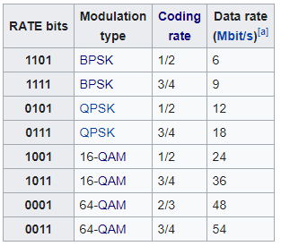
802.11a (1999)
Applied OFDM techniques on the 5 GHz band
Enabled more data throughput 54 Mbps (compare to 11 Mbps for 802.11b)
Multiple rates available
BPSK/QPSK/QAM over OFDM
Quadrature Amplitude Modulation (QAM)
Never reached widespread adoption
Regulatory hurdles in some regions
More complicated hardware delayed it

Slide 88
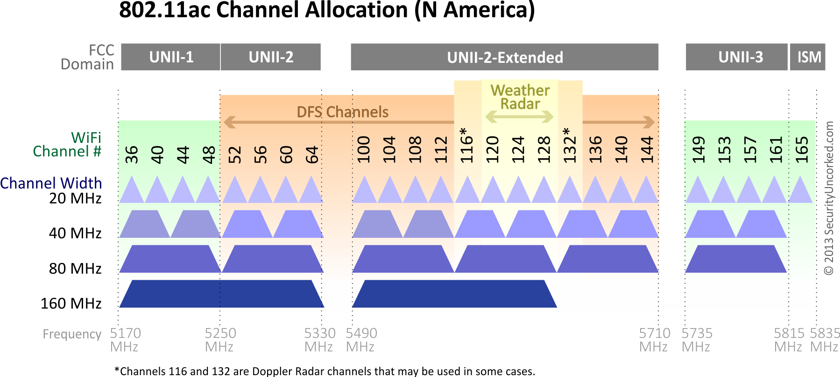
802.11a channels
802.11a did promote the use of 5 GHz band
Several 20 MHz channels with no overlap
Big increase from “three” channels of 2.4 GHz
Various regional rules on a number of different channels
Needs to avoid frequencies in use by existing radar deployments
Orange channels aren’t used, except for enterprise

Slide 89
Major amendments
 | Protocol | Year | Frequency | PHY | Max Rate | Range
- | 802.11 | 1997 | 2.4 GHz | DSSS/FHSS | 2 Mbps | 20 m
1 | 802.11b | 1999 | 2.4 GHz | DSSS | 11 Mbps | 35 m
2 | 802.11a | 1999 | 5 GHz | OFDM | 54 Mbps | 35 m
3 | 802.11g | 2003 | 2.4 GHz | OFDM | 54 Mbps | 38 m
4 | 802.11n | 2009 | 2.4/5 GHz | OFDM + MIMO | 600 Mbps | 70 m
5 | 802.11ac | 2013 | 5 GHz | OFDM + MU-MIMO (downlink only) | 3.4 Gbps | 35 m
6 | 802.11ax | 2021 | 2.4/5/6 GHz | OFDMA + MU-MIMO | 9.6 Gbps | 35 m
802.11b was very popular but is now usually unsupported
802.11a never saw major deployment

Slide 90
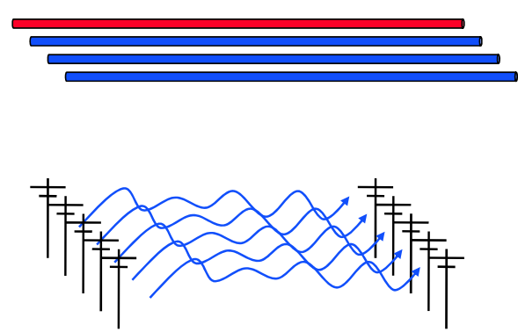
How do we increase throughput?
Wired world
Add more wires in parallel
Wireless world
Add more antennas?

Slide 91
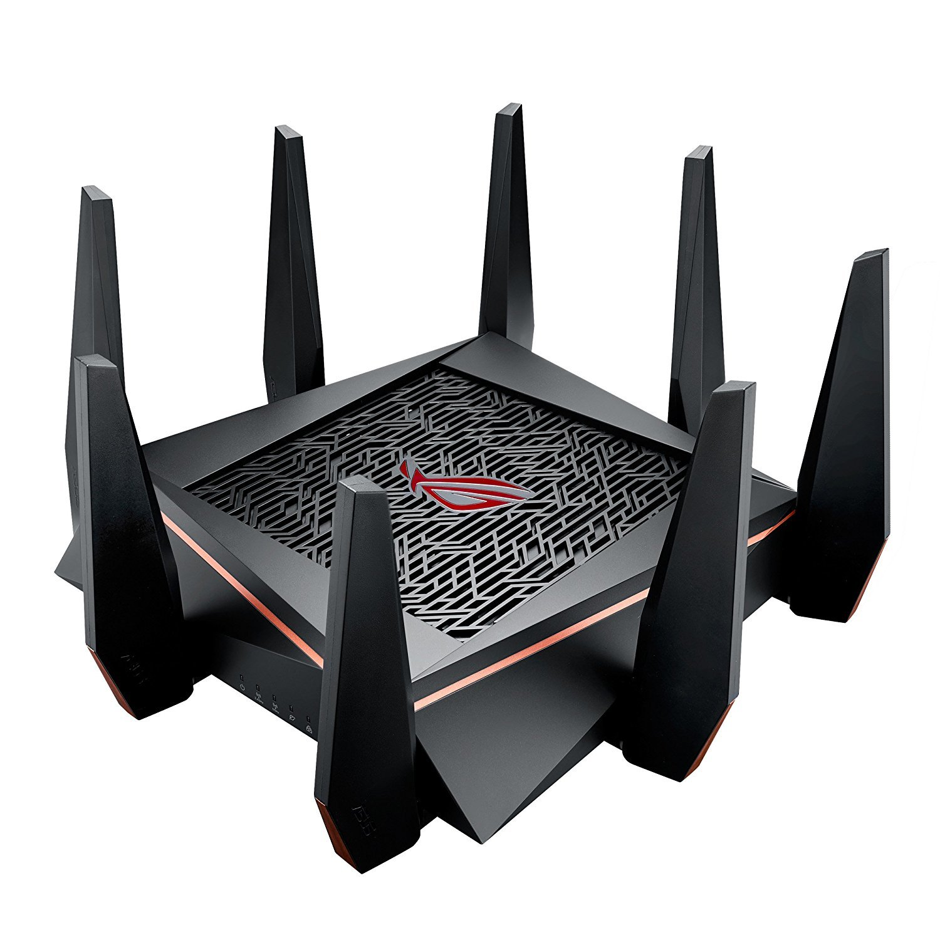
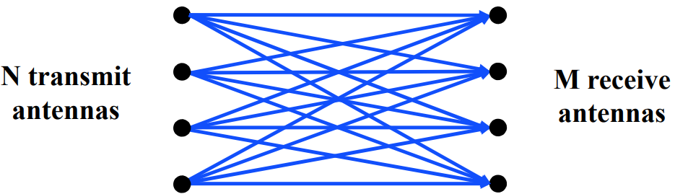
MIMO – Multiple In Multiple Out
N x M subchannels can be used to send data simultaneously
Huge boost in data throughput
Antenna diversity adds to reliability as well
The signals may interfere with each other
But receiving all of them allows the data to be recovered
Beamforming
Use interactions between array of antennas to focus energy on the receiver

Slide 92
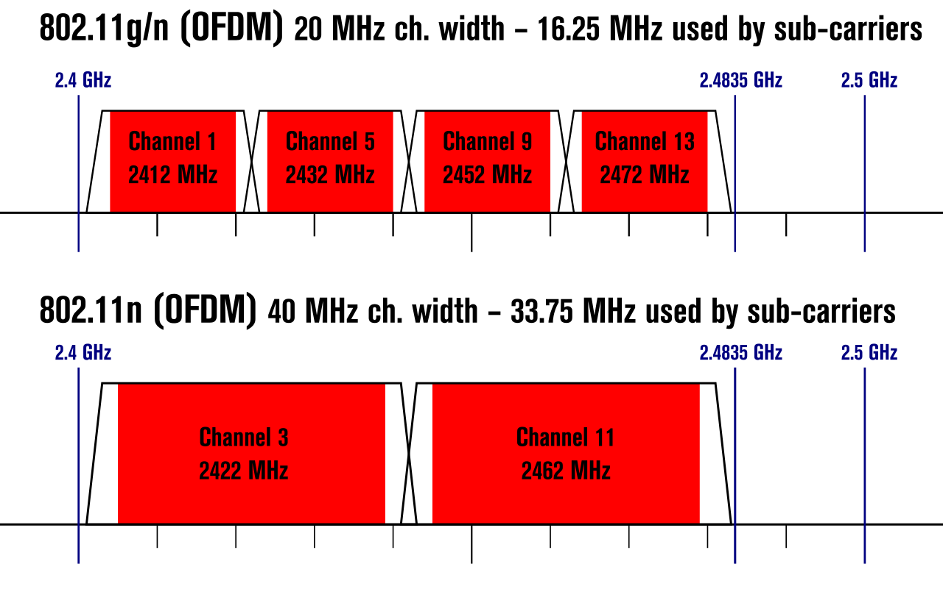
Expandable bandwidth
OFDM allows many subcarriers within a channel to be used at once
Throughput scales with the amount of bandwidth available
Allow larger 40 MHz channels to be used

Slide 93
802.11n (2009)
Supports OFDM and MIMO on 2.4 GHz and 5 GHz
Supports 20 MHz and 40 MHz channels
Easier to create large channels in 5 GHz band
Backwards compatible with 802.11g (tries not to be with 802.11b)
Wildly successful
Still the 2.4 GHz band protocol (802.11ac is 5 GHz only)
A little less than half of the networks visible to me are still 802.11n
My apartment “building WiFi” is still 802.11g…

Slide 94
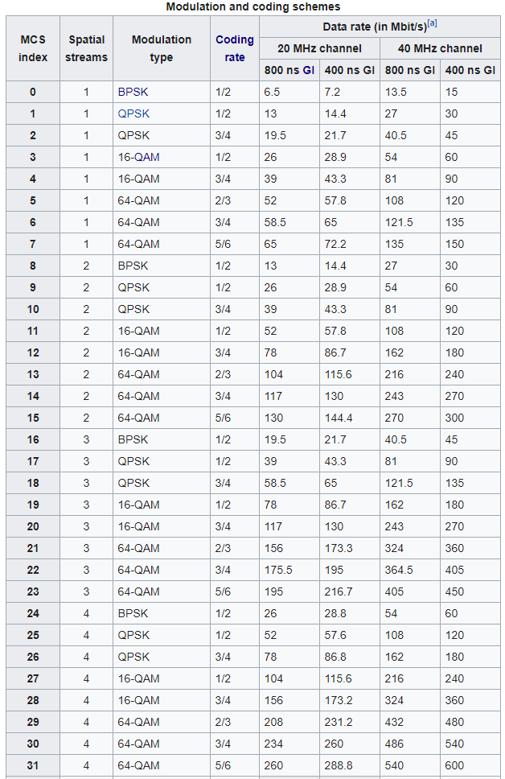
802.11n modulation and coding schemes
MCS – Modulation and Coding Scheme
GI – Guard Interval: delay between transmitted symbols

Slide 95
Major amendments
 | Protocol | Year | Frequency | PHY | Max Rate | Range
- | 802.11 | 1997 | 2.4 GHz | DSSS/FHSS | 2 Mbps | 20 m
1 | 802.11b | 1999 | 2.4 GHz | DSSS | 11 Mbps | 35 m
2 | 802.11a | 1999 | 5 GHz | OFDM | 54 Mbps | 35 m
3 | 802.11g | 2003 | 2.4 GHz | OFDM | 54 Mbps | 38 m
4 | 802.11n | 2009 | 2.4/5 GHz | OFDM + MIMO | 600 Mbps | 70 m
5 | 802.11ac | 2013 | 5 GHz | OFDM + MU-MIMO (downlink only) | 3.4 Gbps | 35 m
6 | 802.11ax | 2021 | 2.4/5/6 GHz | OFDMA + MU-MIMO | 9.6 Gbps | 35 m
802.11b was very popular but is now usually unsupported
802.11a never saw major deployment

Slide 96
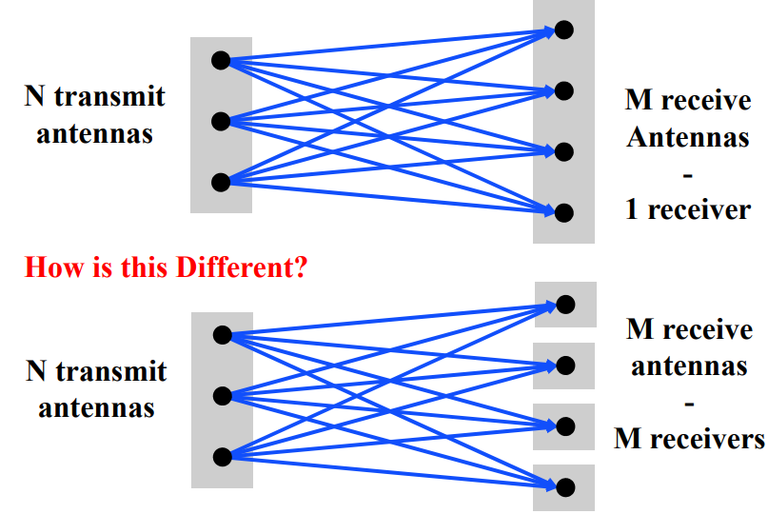

Multi-user Multiple In Multiple Out (MU-MIMO)
Multi-user MIMO uses the same techniques to send in parallel to multiple devices
Devices cannot cancel out interference anymore
Send slower, more reliable data streams to overcome this

Slide 97
802.11ac (2013)
Update for 5 GHz band only
Supports Downlink MU-MIMO (from AP to device)
Supports channels widths up to 160 MHz
Engineering updates: up to 256-QAM
Routers apply 802.11ac to 5 GHz and 802.11n to 2.4 GHz

Slide 98
802.11ac channels

Slide 99

802.11ac modulation and coding schemes
4 spatial streams is also allowed, getting up to 3466 Mbps

Slide 100
Major amendments
 | Protocol | Year | Frequency | PHY | Max Rate | Range
- | 802.11 | 1997 | 2.4 GHz | DSSS/FHSS | 2 Mbps | 20 m
1 | 802.11b | 1999 | 2.4 GHz | DSSS | 11 Mbps | 35 m
2 | 802.11a | 1999 | 5 GHz | OFDM | 54 Mbps | 35 m
3 | 802.11g | 2003 | 2.4 GHz | OFDM | 54 Mbps | 38 m
4 | 802.11n | 2009 | 2.4/5 GHz | OFDM + MIMO | 600 Mbps | 70 m
5 | 802.11ac | 2013 | 5 GHz | OFDM + MU-MIMO (downlink only) | 3.4 Gbps | 35 m
6 | 802.11ax | 2021 | 2.4/5/6 GHz | OFDMA + MU-MIMO | 9.6 Gbps | 35 m
802.11b was very popular but is now usually unsupported
802.11a never saw major deployment

Slide 101
New directions in WiFi focus: Aggregate throughput across all devices
For point-to-point, WiFi is “(more than) fast enough”
Now the problem is the quantity of devices in a single space
Desktop, laptop, tablet, smartphone, smartwatch, IoT devices, etc.
Insight: Bring established cellular techniques to WiFi

Slide 102

Orthogonal Frequency Division Multiple Access
OFDM: split channel into subcarriers and transmit on those
OFDMA: allocate subcarriers to a device for an amount of time
Turns OFDM into an access control mechanism
Complicated question: which device gets which subcarriers at which time?

Slide 103
802.11ax (2021)
Standard approved on February 9th 2021
First devices started supporting it in 2019 (WiFi 6)
6 GHz band (WiFi 6E)
1.2 GHz of bandwidth (5.925-7.125 GHz)
2020: US FCC made band available for unlicensed use!!!
EU is expected to follow in March 2021
OFDMA
MAC scheduling variant of OFDM
Schedule devices based on time and subcarrier allocations

Slide 104

6 GHz band is an enormous amount of bandwidth

Slide 105
Learning Objective for Today’s Lecture
Review: last few lecture’s topics
ZigBee
WiFi
Recall: WiFi Mac
WiFi History
Cellular basics

Slide 106
The first commercial mobile phone was in 1946!
By 1948, 5000 users placing around 30,000 calls weekly
“The equipment, of course employing vacuum tubes, weighed eighty pounds, filled much of a vehicle’s trunk and drew so much power that it would cause the headlights to dim. Service cost $15 per month, plus thirty to forty cents per local call, equivalent to $175 2012 dollars, plus $3.50 to $4.65 per call. “
https://ethw.org/The_Foundations_of_Mobile_and_Cellular_Telephony
https://www.smithsonianmag.com/innovation/first-mobile-phone-call-was-made-75-years-ago-180978003/

Slide 107

The first `mobile` network architecture
Single transmitter tower, multiple receiver towers
Why?
Medium Access Control?
Push-to-talk [half-duplex]
City-wide “party line”
Maximum of three concurrent callers
Notes:
A single transmitter on a central tower provided a handful of channels for an entire metropolitan area. Between one and eight receiver towers handled the call return signals. At most, three subscribers could make calls at one time in any city using the single transmitter and the tiny amount of spectrum allocated by the Federal Communications Commission to this service. It was in effect a massive party line, where a tightly controlled number of subscribers had to listen first for someone else on the line, and, if finding the line free, signal an operator, who would place the call. During the call, the user depressed a button on the handset to talk and released it to listen.

Slide 108
The first `mobile` network architecture
Single transmitter tower, multiple receiver towers
Why? Transmission energy of phone!
Medium Access Control?
Push-to-talk [half-duplex]
City-wide “party line”
Maximum of three concurrent callers
Notes:
A single transmitter on a central tower provided a handful of channels for an entire metropolitan area. Between one and eight receiver towers handled the call return signals. At most, three subscribers could make calls at one time in any city using the single transmitter and the tiny amount of spectrum allocated by the Federal Communications Commission to this service. It was in effect a massive party line, where a tightly controlled number of subscribers had to listen first for someone else on the line, and, if finding the line free, signal an operator, who would place the call. During the call, the user depressed a button on the handset to talk and released it to listen.

Slide 109
1965: The Improved Mobile Telephone Service
”More spectrum”
Bell: VHF Low (35-44 MHz, 9 channels), VHF High (152-158 MHz, 11 channels), UHF (454-460 MHz, 12 channels)
7 channels at VHF, and 12 channels at UHF for "RCCs" (Radio Common Carriers)
These will end up becoming pagers, mostly
“Full Duplex”
Implemented as channel pairs (two half-duplex)
Spectrum alone is not enough
Limited to 40,000 total subscribers
E.g. NYC had 2,000 people on 12 channels with a typical wait of 30 minutes to place a call
Phones fit in a briefcase now
Notes:
Also now full duplex, and no more operators

Slide 110
Quick review: How can we share spectrum?
Frequency division
Already doing that
Time division
Already doing that
Code division
Won’t come to [US…] mobile networks until the 80’s
Spatial division!!

Slide 111
What’s inefficient with this picture?
Early mobile networks handled the mobility challenge with wide-area coverage
The active user could be anywhere in the 40~60 mile range of the transmit tower
So they had exclusive access to that whole area!
12 frequency channels → 12 users

Slide 112
The `cell` in cellular networks
Cell is spatial division
Reduce transmit power, smaller area
Now…
12 / 3 = 4 channels per cell
* 6 cells in area
= 24 users of same spectrum!
And we can choose the cell size based on our expected needs

Slide 113
Spatial division tradeoffs
?
Need more infrastructure (more towers)
Need logic to support handoff
Cellular concept in Bell labs at 1947 [one year after mobile], but no handoff

Slide 114
How often does handoff need to happen anyway?
Really a question of “how big are cells”
A back-of-envelope answer for “Handoffs per 3-minute call”:
 | Speed (mph) | Speed (kph) | Cell Radius (km) | Handoffs
Freeway, rural | 65 | 104 | 16 | 0.33
Freeway, urban | 65 | 104 | 1.6 | 3.25
Surface streets, urban | 30 | 48 | 1 | 2.4
Pedestrian, urban | 1.5 | 2.4 | 1 | 0.12
Pedestrian, microcell | 1.5 | 2.4 | 0.1 | 1.2
Table data from Arthur H. M. Ross, PhD: http://www.cdg.org/technology/cdma_technology/a_ross/handoff.asp

Slide 115
Learning Objective for Today’s Lecture
Review: last few lecture’s topics
ZigBee
WiFi
Recall: WiFi Mac
WiFi History
Cellular basics

Slide 116
Cellular and IoT
Next week: Final lecture. ☺ , short lecture on cellular and IoT

Slide 117
Wireless Networking
Ambuj Varshney
Assistant Professor, National University of Singapore
Wireless, Embedded Intelligence, Sensing, and Emerging Technologies Group
ambujv@nus.edu.sg

